Slide 1
Aging Curves in Women’s Hockey: NWHL Edition
Ben Howell

Slide 2
Why Do Aging Curves Matter?
- Evaluating players and projecting future performance
- Using Game Score per Game (GS/G) to evaluate player production
NWHL Data from TheirHockeyCounts.com and Age from Elite Prospects
Skaters only: G + (0.9 * A1) + (.66 * A2) + (.1 * SOG) + (.11 * FOW) – (.11 * FOL) – (.15 * PENT)
Standardized to z-scores (0 is average, 1 is one-standard deviation above average, etc)
Notes:
Using curves for player eval and future performance (and for uh, fantasy hockey projections if one was inspired by a certain fantasy hockey project previously presented, wink, wink)
Thanks to Mike Murphy for his work on NWHL game score providing us with a strong way to measure player performance
The weights for game score are derived from how often each event occurs relative to a goal
When talking about z-scores: this will come into play later, but given 2021’s shortened season and a max of 7 games for a team, I rescaled games played to be a “full” season

Slide 3
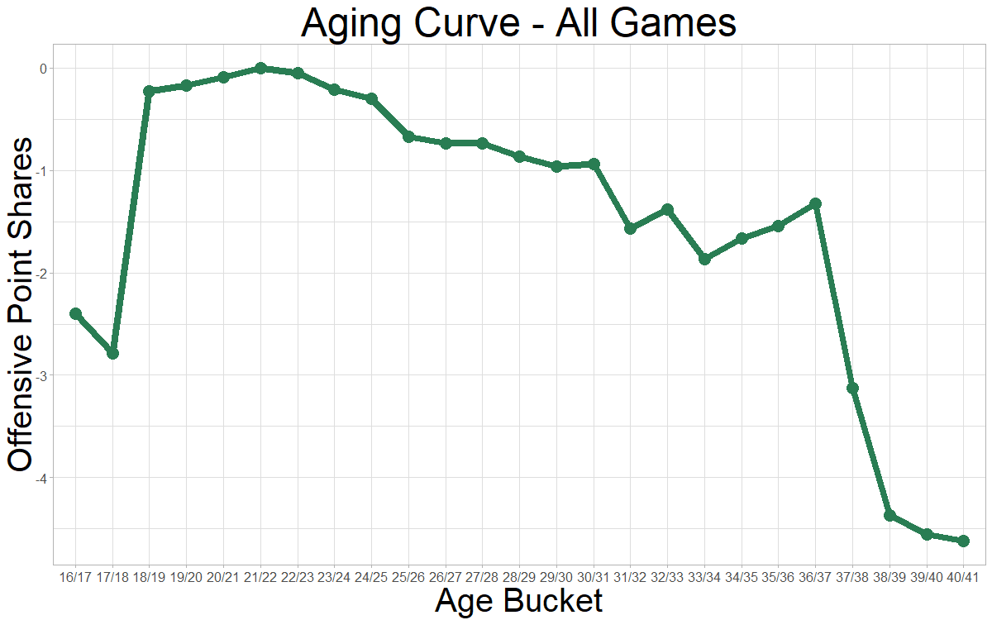
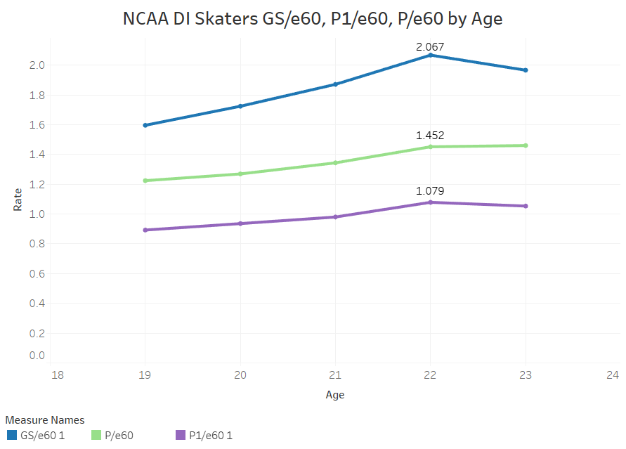
Previous WHKY Aging Work
- Production (whether Game Score or Offensive Point Shares) peaks ~ 22-24 range
In both CWHL (Markey) and NCAA Women’s Hockey (Murphy) using Delta Method
CWHL
NCAA D1
Notes:
In the CWHL, the delta curve indicates that players peak in their early 20s, a claim corroborated by NCAA work. The CWHL curve is interesting and not entirely applicable to the NWHL given that players could begin playing in the CWHL as early as 16, while the same thing does not apply to the NWHL. And the NCAA analysis is tough to draw NWHL conclusions from given that many of the players played in the NCAA before turning pro and going to leagues like the NWHL
Also interesting that the curves peak earlier than most analysis that has been done primarily in men’s sports that find performance peaking in the mid to late 20s, depending on the attribute in question

Slide 4
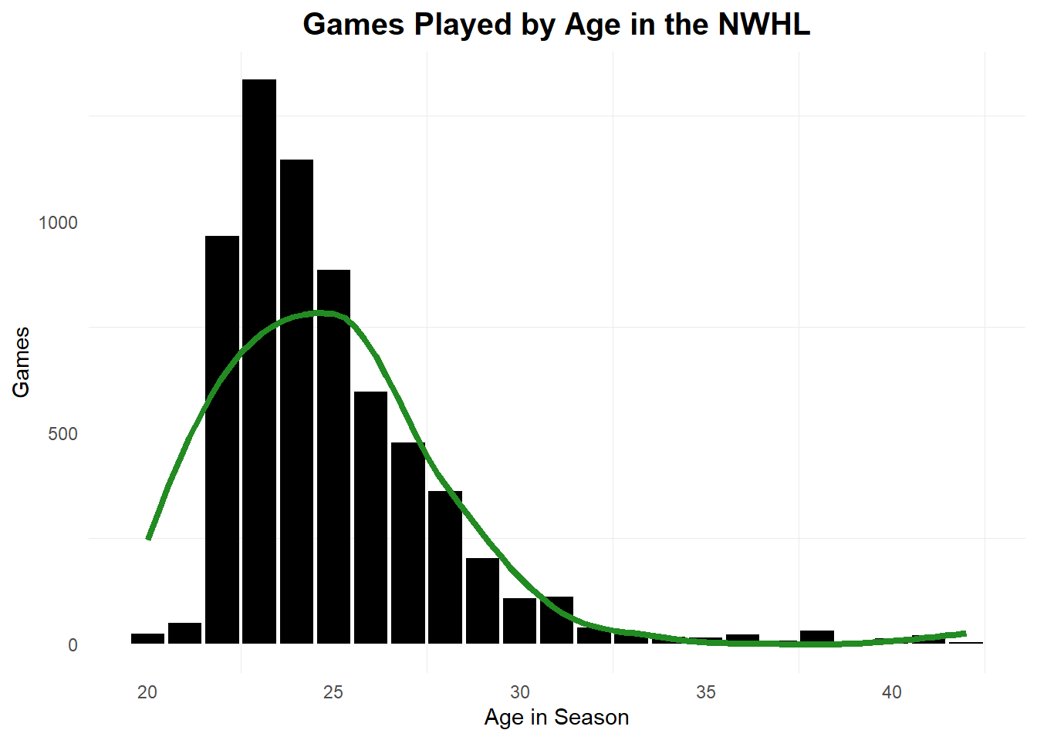
What Needs To Be Addressed?
- Youth of NWHL and high volume of player movement
- Mostly younger players; haven’t seen many long careers in sequence -> evaluate league trends
Seasons Played | 1 | 2 | 3 | 4 | 5 | 6
Number of Seasons | 170 | 66 | 52 | 15 | 6 | 5

Slide 5
Methods for Exploring Aging Curves
- Delta Method: Looking at raw change in GS/G from age to age
Ends up throwing out 1-year players and the final year of each player’s career
- Using Regression techniques with or without career mean as an input
Generalized Additive Models
Linear Regression Models

Slide 6
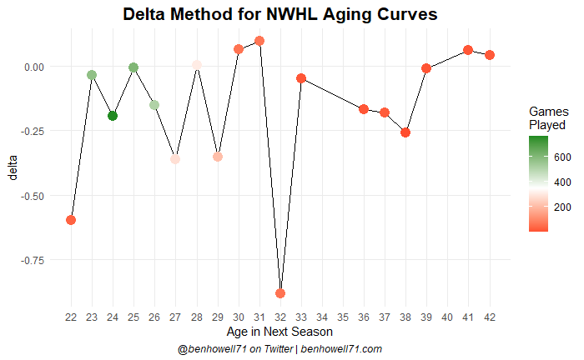
Delta Method
- Remove players who only played one season and remove seasons without a following one
578 player seasons to just 235 seasons
Not a perfect fit for this kind of dataset
Notes:
The delta method of evaluating aging is easy: how much production do players lose/gain from one age to the other?
The graph here shows how much GS/G changed for players in each age bucket

Slide 7
One-and-Done Players
- How do players who return for a sophomore season (survivors) fare as a rookie vs those who don’t return?
- Similar games played, stark difference in effectiveness relative to average
Type of Player | Seasons | Total GP | Avg GP | Game Score vs Avg
Survivors | 144 | 2051 | 14.2 | 0.256
One-and-done | 124 | 1361 | 11 | -0.281
Notes:
Comparing players. Having a below-average season in your rookie year is not a good sign
(We’ve switched back to game score relative to average (z-score) here and should be using GSZ the rest of the way)

Slide 8
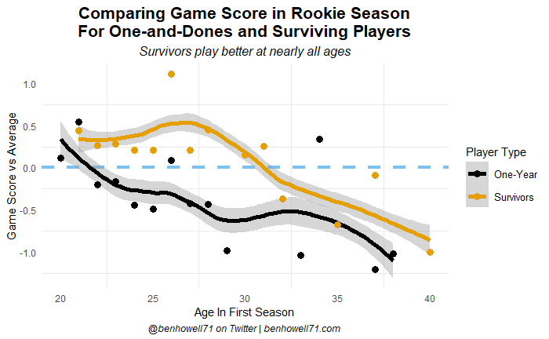
One-and-Done Players
- Downward trends overall, but survivors play better at nearly every age
- Below-average first season = Not a good sign for NWHL longevity
Notes:
The few ages that one-and-dones “win” are like age 34 where there were no other players, etc
Biggest gaps come from that 22-29ish range which is interesting

Slide 9
Regression Methods
- Regressing to career mean is difficult given the limited sample of players with enough seasons
- Linear regression results in flat decline
- GAM function: GS/G ~ (age_in_season ^ 2) + age_in_season produces a parametric curve
Could use above equation with LR, but LR wants a symmetric curve, while the GAM model doesn’t care
Notes:
Would normally like to include a player’s career mean in how we evaluate their aging relative to their performance because a star dropping to merely “good” is a larger drop than an “average” player who becomes below replacement level—naturally we have issues with that using the NWHL data

Slide 10
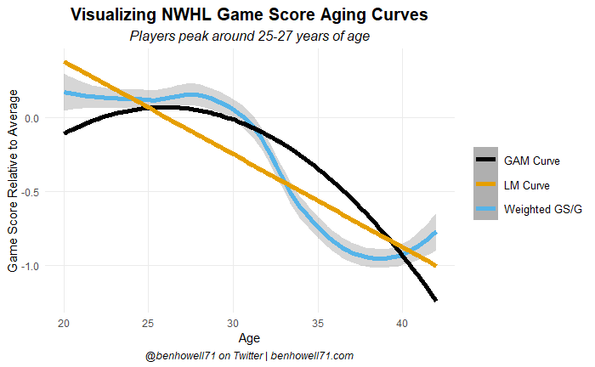
Regression Methods

Slide 11
MARCEL Projections
- Popularized in baseball by Tom Tango
- Weighted average of the last 3 seasons based on relationship with next year GS/G
Weights developed from CWHL data due to lack of sustained NWHL playing time
Y1 ~ 0.6, Y2 ~ 0.3, Y3 ~ 0.2
- Then regressed to NWHL average GS/G at player’s next age
Roughly 3 games of average production added -> penalizes player with less playing time
Notes:
Relatively simple and not model-heavy, but given the situation, I don’t think a heavy model is best-suited to projecting players when this is what we have

Slide 12
Top and Bottom NWHL Skaters in Projected 2022 Game Score
Player | Next Age | 2021 GS/G | 2022 Predicted GS/G
Mikyla Grant-Mentis | 23 | 1.92 | 1.91
Jillian Dempsey | 30 | 1.59 | 1.64
McKenna Brand | 25 | 1.19 | 1.31
Christina Putigna | 24 | 1.31 | 1.28
Rebecca Morse | 29 | 0 | 0.17
Laurel Hill | 30 | -0.02 | 0.13
Chelsey Brodt Rosenthal | 38 | -0.09 | -0.04
Notes:
MGM is a good bet to repeat as league MVP. Dempsey continues her run as a superstar. McKenna Brand takes a step forward. Brand, Dempsey, Putigna look like they’ll keep the Boston Pride in the contention for next season’s NWHL title

Slide 13
Issues + Next Steps
- Lots of them!
- NWHL is a very young league and has lots of player movement in and out
Players going to other leagues, national team centralization
Older players can’t necessarily afford to continue playing + limited practice time
- Working with league equivalency models to pair data over a player’s entire career

Slide 14
Thank You!
- Huge thank you to Alyssa, Carlie, and Mike for putting WHKYHAC together!
- Can find me on Twitter @benhowell71
- Code (and a writeup) will be posted on GitHub at a slightly later date!

